Slide 1
C. Corbière, N. Thome, A. Bar-Hen, M. Cord, and P. Pérez, “Addressing Failure Prediction by Learning Model Confidence,” in NeurIPS, 2019.
2020.5.8
胡敬玉

Slide 2
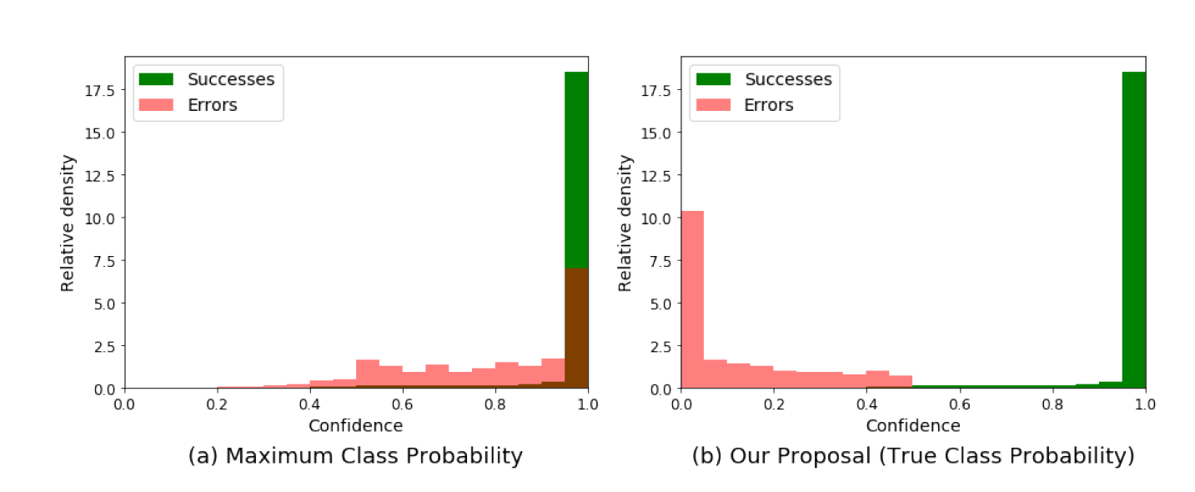
问题
Maximum Class Probability
True Class Probabiliy

Slide 3
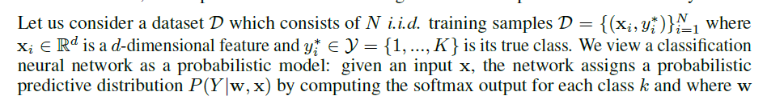
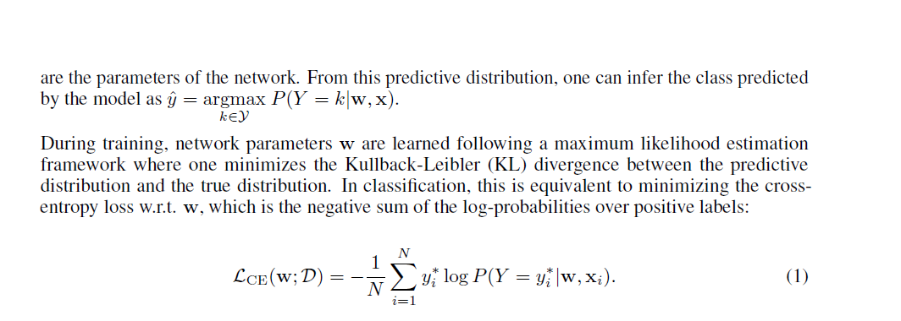
定义

Slide 4
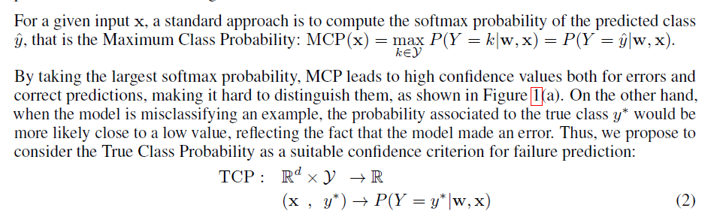
定义

Slide 5
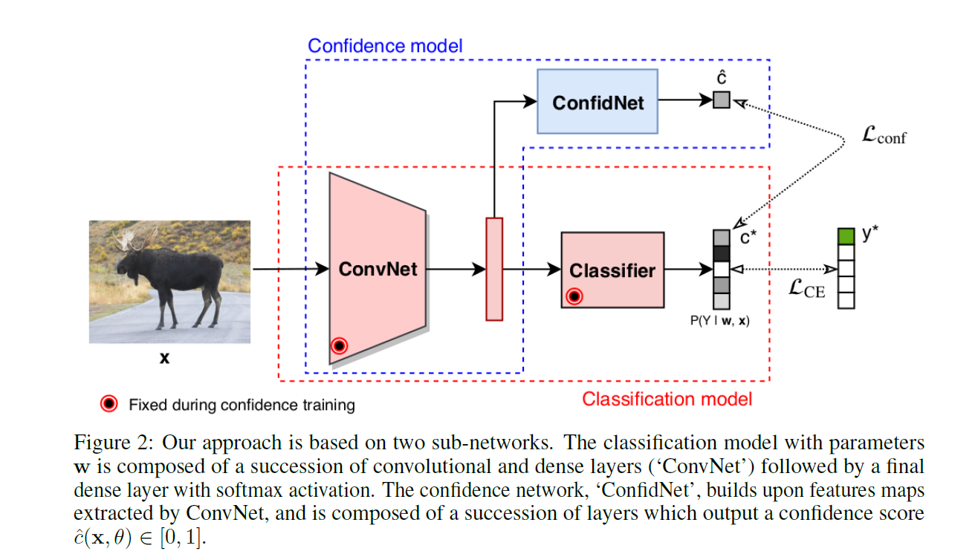

Slide 6
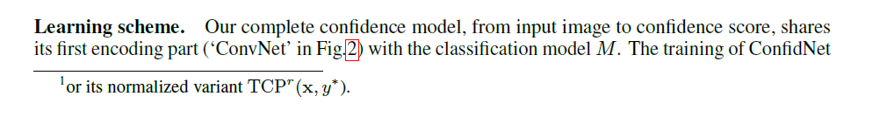
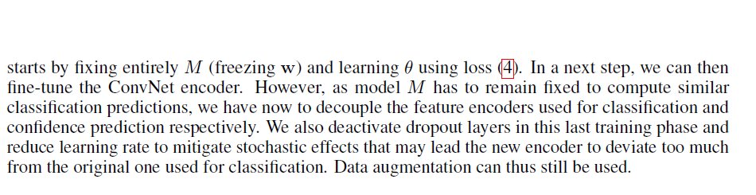
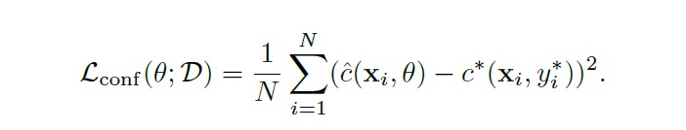

Slide 7
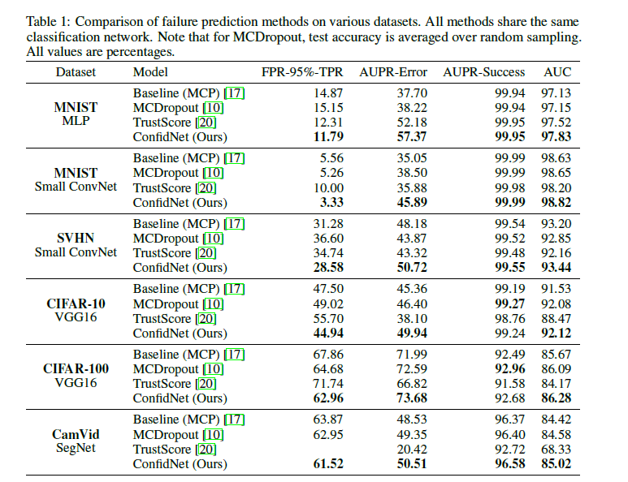

Slide 8
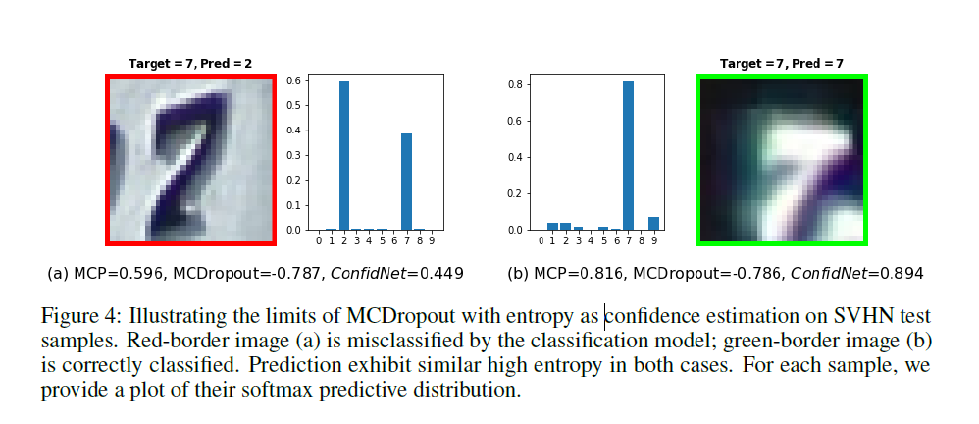

Slide 9
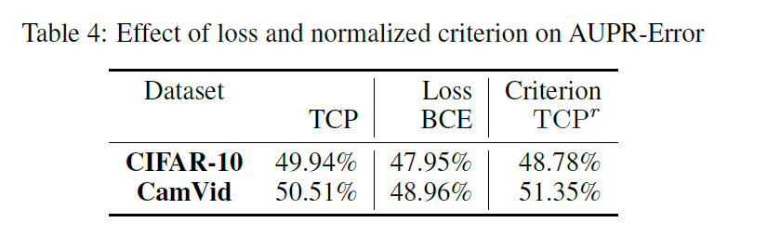

Slide 10
Thank You!

